Slide 1
Uncrewed Systems
in the TAC
Scott Glenn
Rutgers University, USA

Slide 2
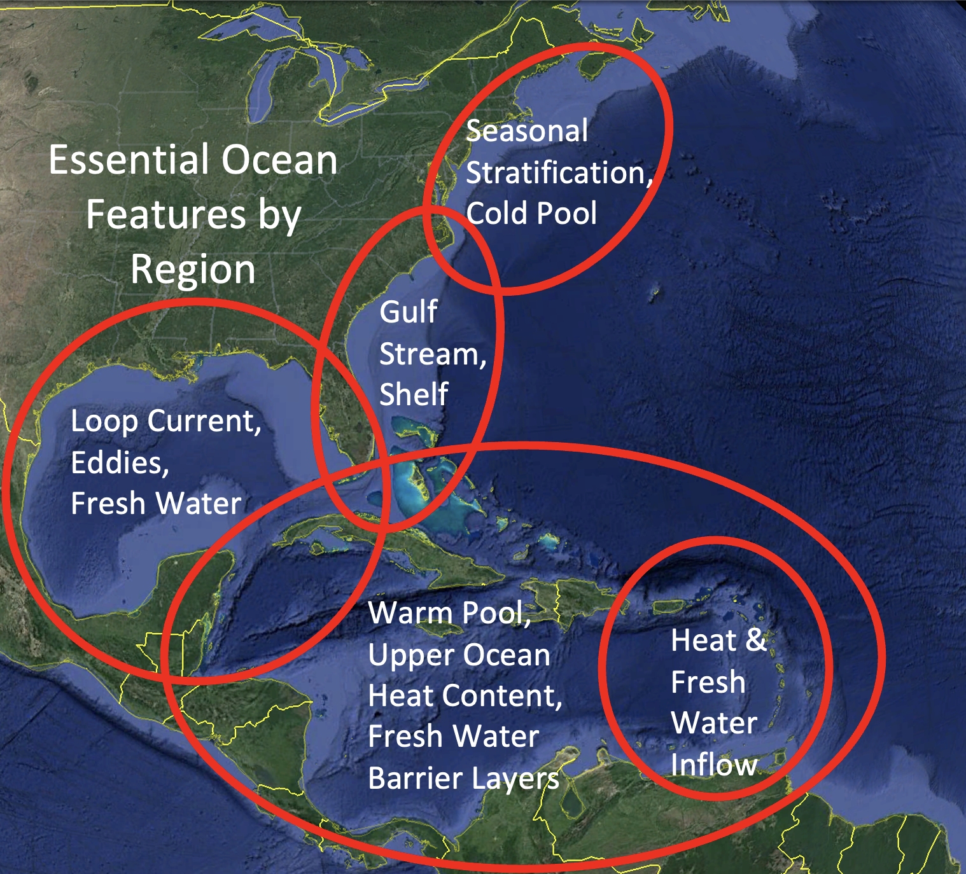
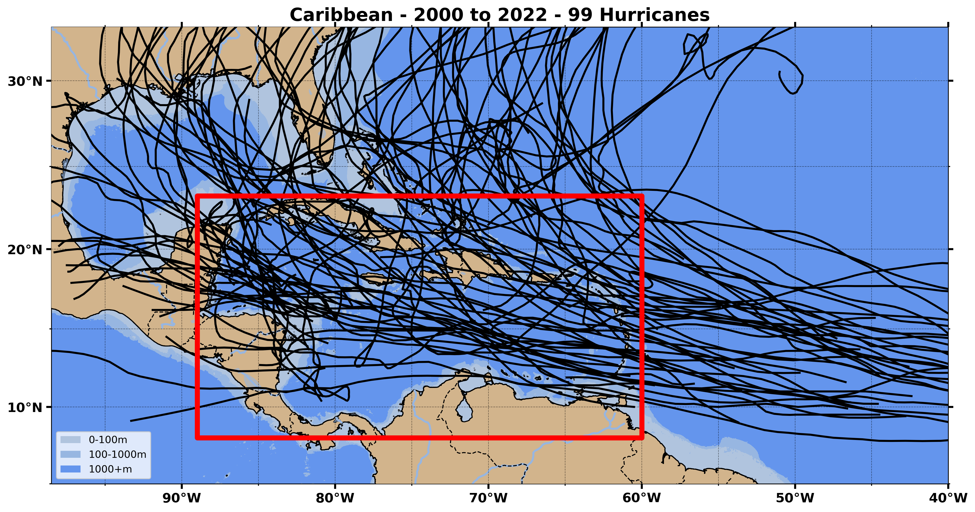
Hurricane Tracks & Essential Ocean Features
Essential Ocean Features impacting hurricane intensity are known

Slide 3
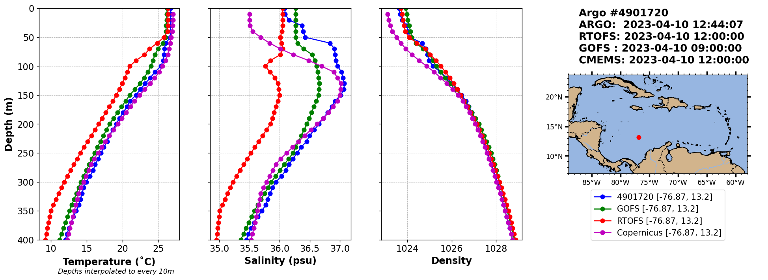
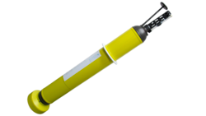
Operational Forecast Model Differences
Argo Data
RTOFS - NOAA
GOFS - Navy
CMEMS - European
Quote from NOAA Environmental Modeling Center: “We are limited by a dearth of subsurface ocean data for assimilation”

Slide 4
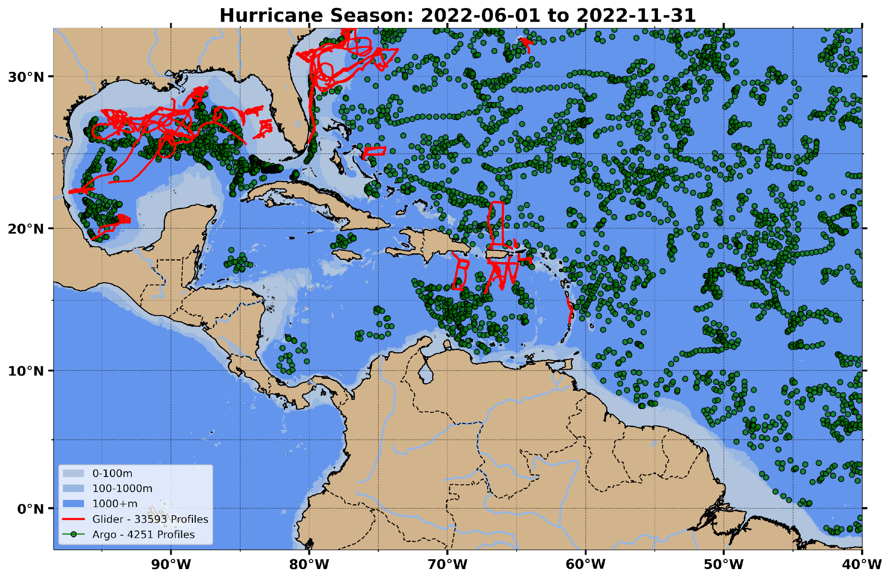
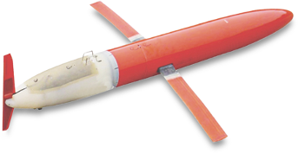
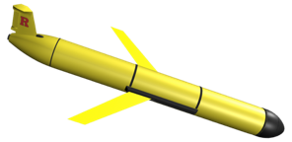
2022 Ocean Subsurface Profile Data
Green: Argo Float Profile Locations (Global)
Red: Underwater Profiling Glider Tracks
(US, Mexico, Bermuda, Bahamas, Puerto Rico, Virgin Islands, Dominican Republic, Martinique)
Data Gaps

Slide 5
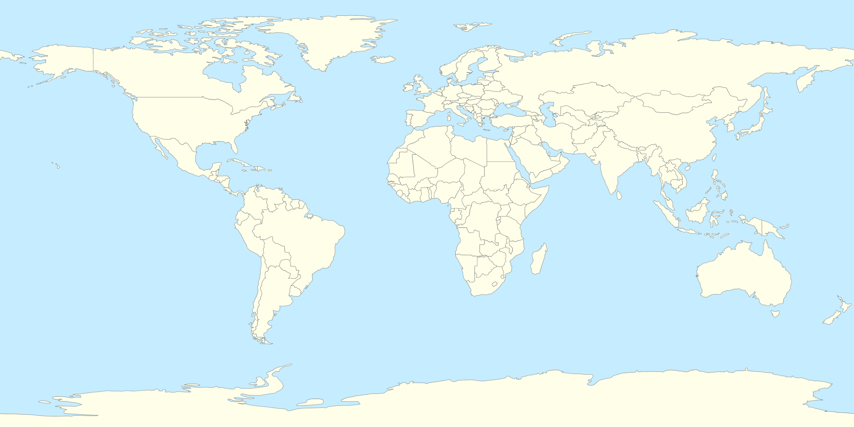
TROPICAL CYCLONES Exemplar
Pilot Study Regions
Co-Design Supporters Forums – February 1 and 8 at 0900 EST
Overview talk presented by Emma Heslop & David Legler
Ocean Decade Challenge #7 – Expand GOOS
(a) Capacity Development, (b) Extending Obs to the Coast, and (c) Co-Design
Overview talk featured two Exemplars – Ocean Carbon and Tropical Cyclones
Questions answered by Emma Heslop, David Legler & Sabrina Speich
Some key questions from potential supporters:
Role of governments vs philanthropic organizations?
Expected outcomes after two years?
Plans for capacity building?
Tropical Americas & Caribbean Region (TAC)
North Pacific Ocean and Marginal Seas (NPOMS)
North East Indian Ocean (NEIO) - Bay of Bengal
South West Indian Ocean (SWIO)
Benefits
Co-designed, regionally distributed ocean observing pilot studies - to develop collaborative capacity and demonstrate mutual value
Increased coverage and delivery of ocean data to forecasting centers and scientists – to expand critical observations across international boundaries
More accurate characterization and understanding of essential ocean-atmosphere features and processes – to improve Earth System Models and tropical cyclone forecasts

Slide 6
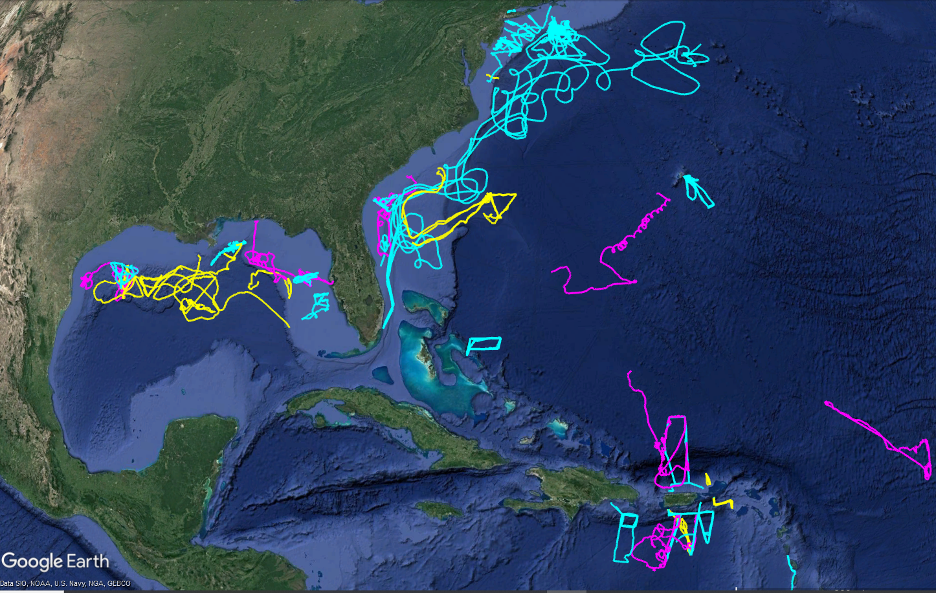
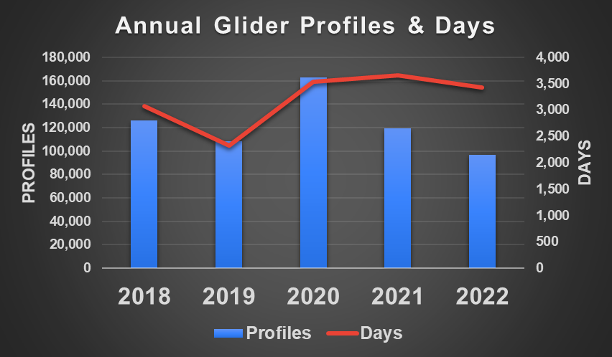
2022 NOAA Operations Overview
2022 Completed
3,432 Glider Days
96,625 Ocean Profiles into GTS
Saildrones
Ian
Nicole
Ian
Earl
Fiona
Gliders
NOAA/Partner Gliders
U.S. Navy Gliders
Hurricane Intensity Saildrone Project
Notes:
Glider Days: The cumulative number of days that all gliders were at sea collecting observations. This is a similar metric as Days At Sea for ships.
2022 Completed Glider Days and GTS Profiles: Computed for all Atlantic basin gliders in the water between Jun 1 and Nov 30, 2022
Annual Glider Profiles & Days: Chart data is for Jun 1 to Nov 30 for all Atlantic basin glider observations
Profiles Days
2018 126,309 3,068
2019 108,373 2,321
2020 163,006 3,542
2021 119,013 3,684
2022 96,625 3,432

Slide 7
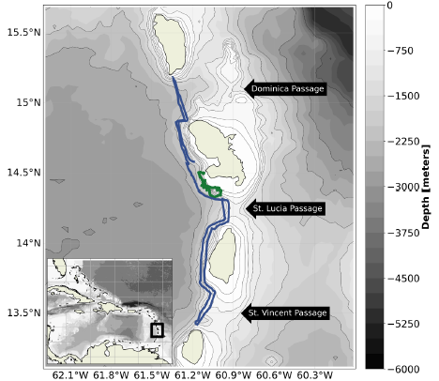
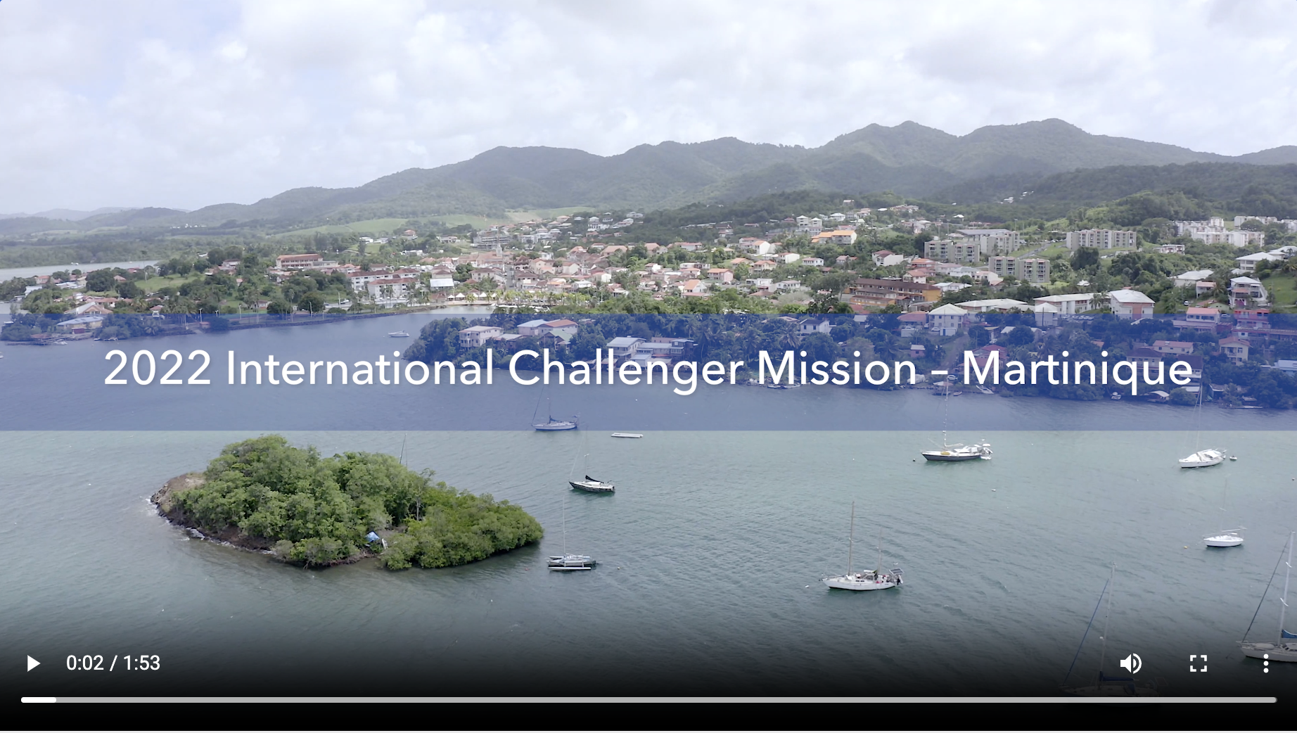
Vetlesen Foundation Contributions - Inflow
Hurricane Gliders observe transports of water, heat and salt through through inter-island passages
Hurricane Gliders, equipped with additional acoustic sensors, can also listen for whales
https://rucool.marine.rutgers.edu/martinique/

Slide 8
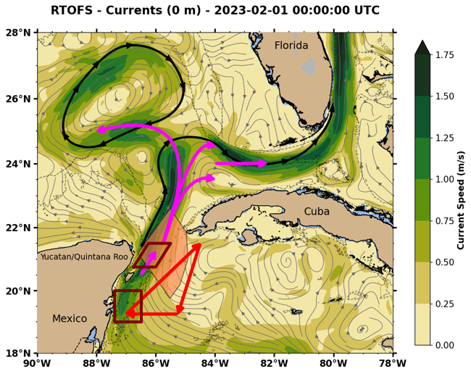
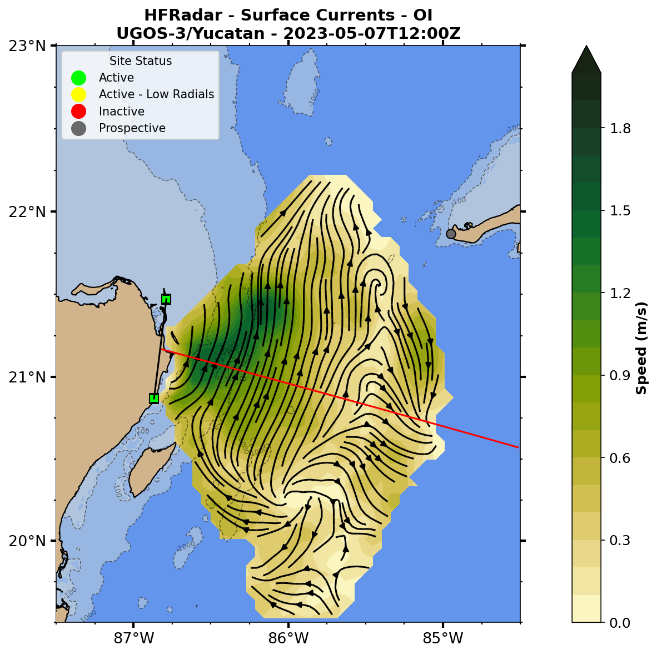
US National Academies Contributions - Outflow
HF Radar Caribbean Gliders Drifters & Floats GoM Gliders
Yucatan Strait HF Radar
https://rucool.marine.rutgers.edu/ugos-hfr/

Slide 9
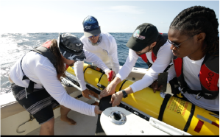
What Gaps Remain?
We have:
An Intergovernmental Organization – IOCARIBE-GOOS
A UN Ocean Decade-endorsed framework & approach – TAC-OOFS & Co-Design
The Co-Design Tropical Cyclone Exemplar Pilot Study as a high-impact rally point
Initial investments by NOAA, Vetlesen Foundation, National Academies, and others
We need:
Continued investments in equipment and operations by governments and foundations
Establish a network of Gliderports, Saildrone-ports, Float & Drifter deployment vessels, HF Radar sites
Mechanisms to enable uncrewed systems to collect operational forecast data across national boundaries
Training and Capacity Building across member states to sustain the network for years to come
Glider student training at UVI

